Slide 1

Supervised Learning Algorithms
Agenda
Introduction to SVM
SVM Mathematical Intuition
Best Practices

Slide 2
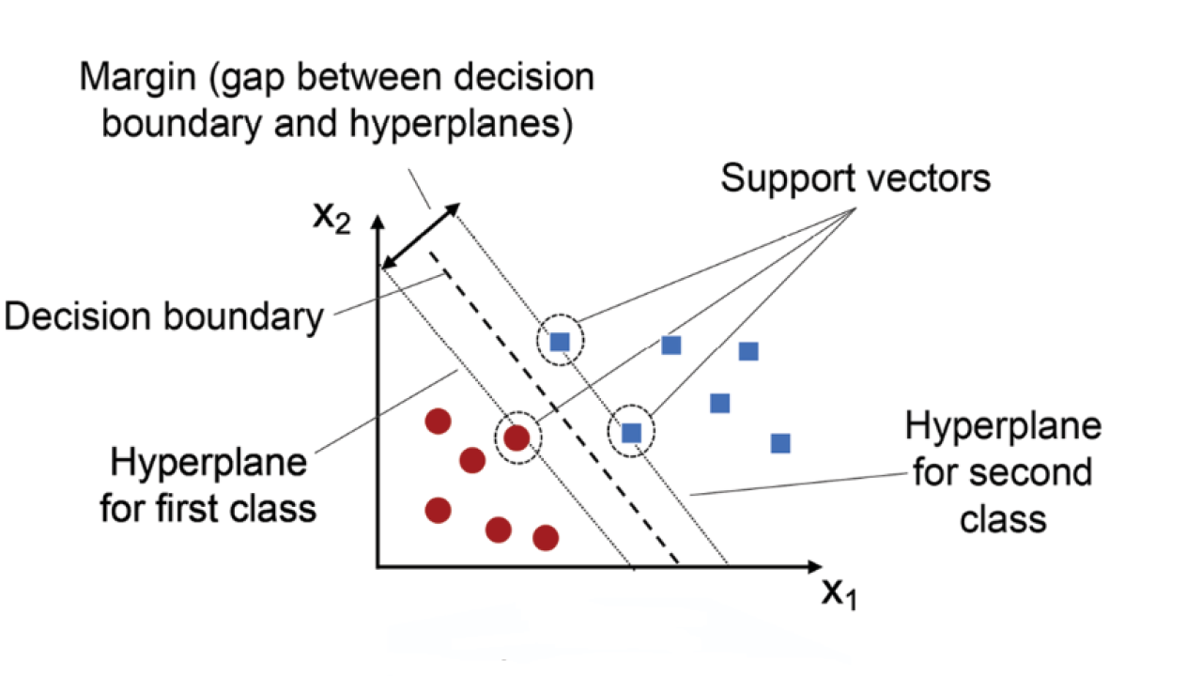
Support Vector Machine (SVM)
Definition:
SVM is a supervised learning algorithm used for classification and regression.
It finds the optimal hyperplane that best separates the data into different classes.

Slide 3
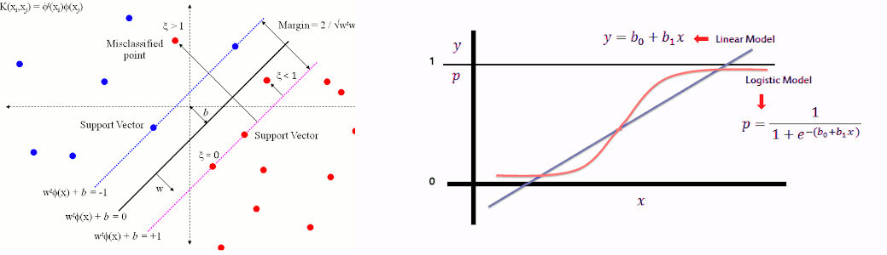
Support Vector Machine (SVM)
Why Use SVM? ✅ Works well with high-dimensional data. ✅ Effective for both linear and non-linear classification. ✅ Robust to outliers due to margin maximization.

Slide 4
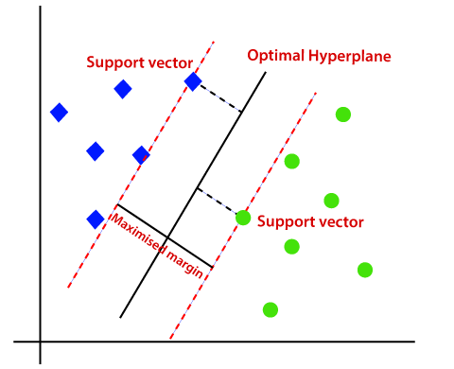
Support Vector Machine (SVM)
Concept of Hyperplane & Margin
Key Terms:
Hyperplane → The decision boundary that separates two classes.
Margin → The distance between the hyperplane and the closest data points.
Maximum Margin Classifier → The goal of SVM is to maximize the margin.
Support Vectors: The Core of SVM
What are Support Vectors?
The data points closest to the hyperplane that influence its position.
Removing a support vector can change the decision boundary.

Slide 5
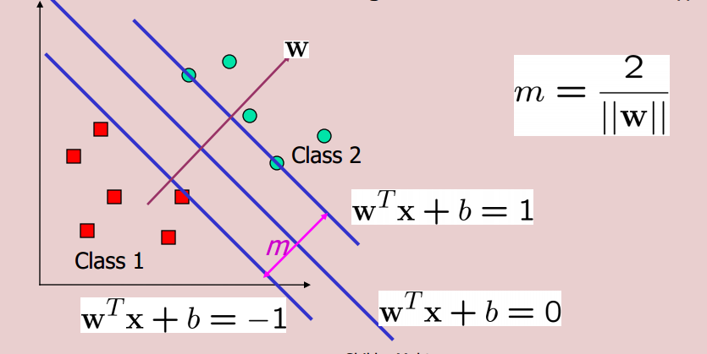


Mathematical Formulation of SVM
Maximize Margin → Find the hyperplane that maximizes the distance from the nearest data points.
Equation of Hyperplane: w⋅x+b = 0
Optimization Problem:
Subject to:

Slide 6
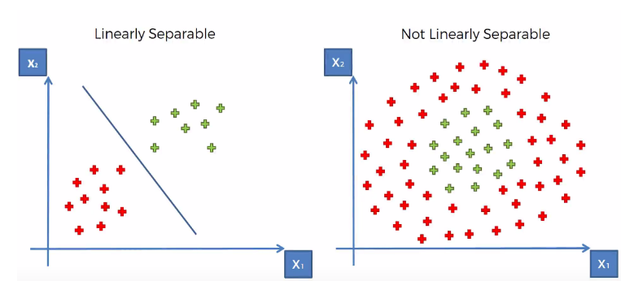
Handling Non-Linearly Separable Data
What if data is not linearly separable?
SVM uses Kernel Trick to transform data into a higher dimension.
Makes it possible to find a linear separation in transformed space.

Slide 7
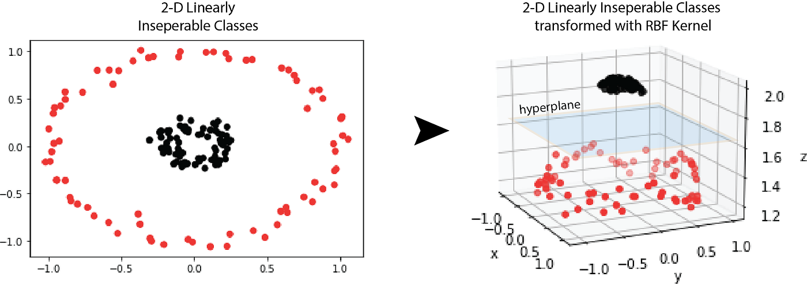
Kernel Trick: The Magic of SVM
What is a Kernel?
A function that maps data to a higher-dimensional space to make it linearly separable.

Slide 8
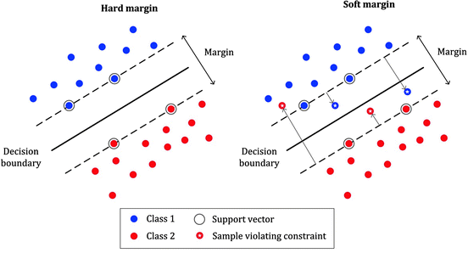
Soft Margin vs. Hard Margin
What if data is noisy?
Hard Margin SVM → Requires perfect separation (not practical for real-world data).
Soft Margin SVM → Allows some misclassification but minimizes the error.
Controlled by C (Regularization Parameter):
Large C → Hard margin (less flexibility, more overfitting).
Small C → Soft margin (more flexibility, better generalization).

Slide 9
Practical Considerations & Best Practices
When should you use SVM? ✅ Works well for small to medium datasets. ✅ Best for high-dimensional spaces. ✅ Effective for text classification, image recognition.
Challenges & Alternatives: ❌ Slower for large datasets → Consider Random Forest, XGBoost. ❌ Sensitive to hyperparameter tuning → Use Grid Search, Cross-validation.

Slide 10
Thank You

